Slide 1
FROM ALERT TO ARCHIVE · TDMMA 2026
COLD OPEN
1 / 33
CASSA TDMMA 2026 · IUB DHAKA · 7–11 SEPTEMBER
From Alert
to Archive
Automated ground-based follow-up for LSST transients — building an observatory that decides, points, and archives without anyone awake.
SESSION · GROUND-BASED FOLLOW-UP INDEPENDENT UNIVERSITY, BANGLADESH CRITO CONTROL PLANE
OPEN
WHY
PIPELINE
DETECTORS
EXPOSURE
SIMULATOR
NODE
Notes:
Open cold, before any software. Set the frame: this talk is about the machinery that turns an alert into a calibrated data point — and about what a 200 mm telescope on a roof in Dhaka can honestly contribute. Say CRITO once, then don't say it again for five minutes.

Slide 2
FROM ALERT TO ARCHIVE · TDMMA 2026
COLD OPEN
2 / 33
COLD OPEN
02:14. A candidate fades over the Bay of Bengal.
ALERT
Rubin sees something that wasn't there last night
IS IT REAL?
Or a cosmic ray, a satellite, a bad subtraction
IS IT MINE?
Above 30° from this roof, tonight, away from the Moon
DECIDE
Worth the next 40 minutes of a telescope's life?
OBSERVE
Point, solve, focus, guide, expose ×N
ARCHIVE
Calibrated, plate-solved, provenance intact — or it never happened
That is ground-based follow-up. Everything after this slide is mechanism.
OPEN
WHY
PIPELINE
DETECTORS
EXPOSURE
SIMULATOR
NODE
Notes:
Walk the chain out loud, slowly, with no software in it. Every one of these six beats is a decision or a mechanism someone has to own. Land the last line hard: everything after this slide is mechanism.

Slide 3
FROM ALERT TO ARCHIVE · TDMMA 2026
WHY IT'S HARD
3 / 33
WHY IT'S HARD
Six orders of magnitude, every night.
~10M
~10³
~10
ALERTS / NIGHT · RUBIN LSST
SURVIVE A USEFUL SCIENCE FILTER
ONE SMALL TELESCOPE, ONE NIGHT
The gap between the first number and the last one is the problem. It cannot be closed by looking harder — only by deciding better, and by there being more of us, spread further around the planet.
OPEN
WHY
PIPELINE
DETECTORS
EXPOSURE
SIMULATOR
NODE
Notes:
Check the current Rubin figure before the talk. The point is not the exact number, it's the ratio: six orders of magnitude between what the survey emits and what one small telescope can absorb in a night.

Slide 4
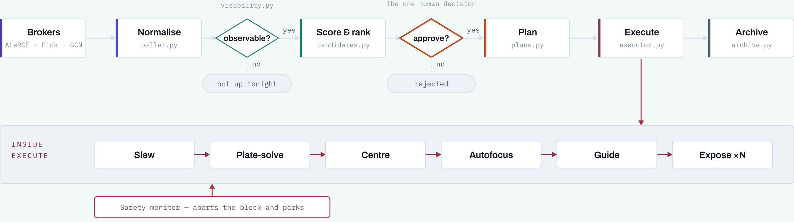
FROM ALERT TO ARCHIVE · TDMMA 2026
THE PIPELINE
5 / 33
CRITO
Alert to archive, as seven stages.
also in the chain: almanac.py · approvals.py · exposure.py · precision.py · calibration.py · safety.py
Two filters and one decision. The machine decides what is worth showing you; a person decides what is worth doing. Everything to the right of that diamond runs unattended — and the safety monitor can interrupt it at any point without asking anyone.
OPEN
WHY
PIPELINE
DETECTORS
EXPOSURE
SIMULATOR
NODE
Notes:
Walk left to right once, then stop on Approve. That's the deliberate human gate: the machine decides what's worth showing, a person decides what's worth doing. The filenames are real modules.

Slide 5
FROM ALERT TO ARCHIVE · TDMMA 2026
THE PIPELINE
6 / 33
CRITO
The boring parts are the entire difference.
DEVICE-AGNOSTIC
SAFETY FSM
CALIBRATION
CLOSED LOOPS
Everything speaks INDI — any brand of mount, camera, focuser, wheel or dome. No hardware model is hardcoded anywhere.
SAFE → WARN → UNSAFE → FAULT
Rain or wind aborts the block and parks the mount. A hardware watchdog parks it even if CRITO dies.
Masters auto-matched to science frames by gain, temperature and filter. Raw frames are never modified in place.
ASTAP plate-solve and centring, HFR autofocus, PHD2 guiding, three-point polar alignment — all measured, none assumed.
~13 200 lines Python · ~11 800 lines TypeScript · 305 tests passing
OPEN
WHY
PIPELINE
DETECTORS
EXPOSURE
SIMULATOR
NODE
Notes:
This is the credibility slide. Dwell on the watchdog: the mount parks even if the control process itself dies — that's the difference between a demo and something you'd leave running.

Slide 6
FROM ALERT TO ARCHIVE · TDMMA 2026
DETECTORS
8 / 33
DETECTORS
Four instruments, four different questions.
IMAGING PHOTOMETRY
MULTI-BAND PHOTOMETRY
SPECTROSCOPY
HIGH-CADENCE TIMING
Is it real, where exactly, how bright?
A CCD or CMOS behind a broadband filter. Gives the light curve, sub-arcsecond astrometry, and the confirmation that the alert was not a subtraction artefact. This is what we have.
How hot, how reddened?
The same detector through a filter wheel. Colour evolution separates thermonuclear from core-collapse supernovae days before a spectrum could. We have this too.
What is it, and how fast is it moving?
Type, redshift and ejecta velocity from line identifications and widths. The only instrument that actually classifies. We do not have this.
What changes in seconds?
Short subs on a fast detector: eclipses, flares, GRB afterglow decay. Needs low read noise more than it needs aperture — a CMOS strength.
A follow-up network divides this labour deliberately. Small nodes supply the cadence and the coverage; a handful of large apertures supply the classification. Knowing which column you are in is what makes you useful.
OPEN
WHY
PIPELINE
DETECTORS
EXPOSURE
SIMULATOR
NODE
Notes:
Orientation for the students, and a frame for everything after. The honest line: we own the first two columns and none of the third. Photometry tells you a transient is real, where it is and how it fades; only a spectrum tells you what it is.

Slide 7
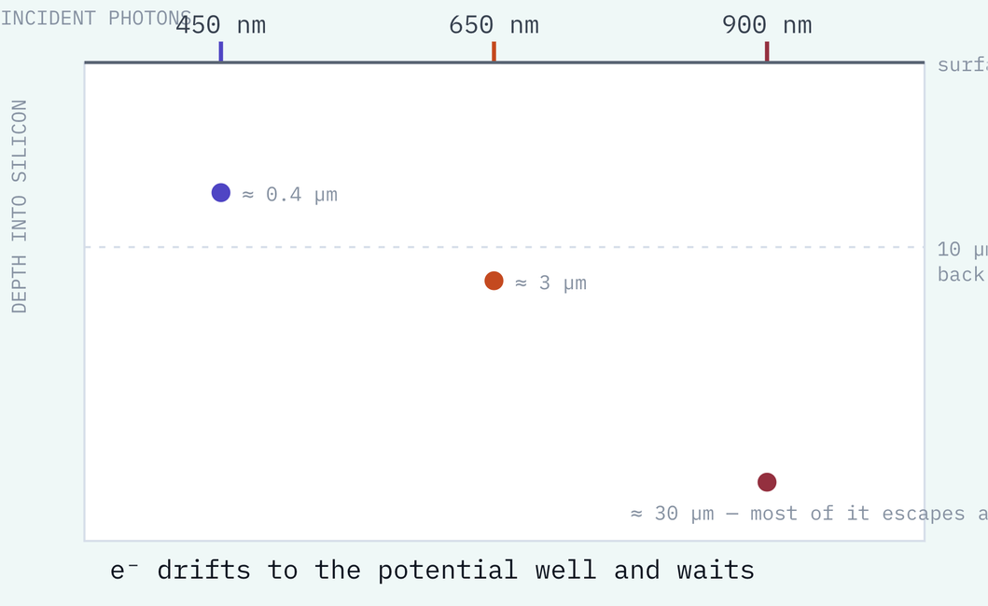
FROM ALERT TO ARCHIVE · TDMMA 2026
DETECTORS
9 / 33
DETECTORS · FROM PHOTON TO NUMBER
A photon becomes an electron, or it passes straight through.
Past 1100 nm, nothing happens
Silicon's bandgap is 1.12 eV. A photon carrying less than that cannot lift an electron across it and passes straight through. That one number is the red edge of every silicon detector ever built.
One photon, one electron
In the optical the surplus energy goes to heat, so there is no multiplication. Quantum efficiency is a probability — electrons collected divided by photons arriving — not a gain.
Colour decides where it lands
Blue stops in the first micron; red drives tens deep. Front-illuminated chips lose the blue in the gate structure above the silicon, so good sensors are thinned and lit from behind — our IMX585 among them.
Then the well fills
An electric field sweeps the photoelectron into a potential well, where it waits until read out. Full well is where it overflows: a CCD bleeds down the column, a CMOS pixel simply clips.
Quantum efficiency, spectral response and full well are all fixed here — before a single transistor is involved
OPEN
WHY
PIPELINE
DETECTORS
EXPOSURE
SIMULATOR
NODE
Notes:
Start here and everything downstream is bookkeeping. Three facts do all the work: silicon stops seeing past 1100 nm, one optical photon makes exactly one electron, and where that electron is created depends on colour. The last one is why back-illuminated sensors exist and why thinned chips fringe in the red.

Slide 8
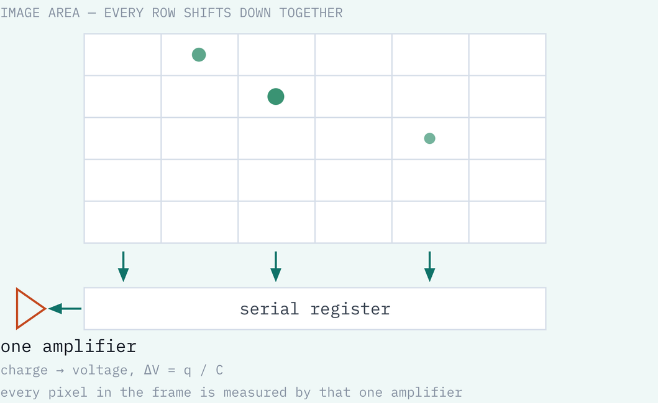
FROM ALERT TO ARCHIVE · TDMMA 2026
DETECTORS
10 / 33
DETECTORS · FROM PHOTON TO NUMBER
CCD: walk the charge across the chip, measure it once.
Clocking
Each pixel is a MOS capacitor. Cycling the gate voltages walks the potential minimum sideways and drags the charge packet with it — every row down one step, then out of the serial register one pixel at a time.
One sense node
At the corner the packet lands on a floating diffusion of capacitance C, giving dV = q/C. Conversion gain is 1/C, quoted in microvolts per electron: smaller capacitance, bigger signal.
Correlated double sampling
Resetting that node leaves sqrt(kTC)/q electrons of uncertainty. Sample it after the reset, sample it again after the charge arrives, subtract — and the reset noise cancels itself out.
The bargain
Every pixel is measured by the same electronics, so the response is superbly uniform — one gain, one linearity curve for the whole chip. The price is serial readout, and transfer efficiency better than 0.99999.
OPEN
WHY
PIPELINE
DETECTORS
EXPOSURE
SIMULATOR
NODE
Notes:
The bucket-brigade image is the one people remember: the charge itself is physically walked across the chip to a single amplifier. Draw the consequence out loud — one amplifier for every pixel is why CCDs are still the reference for precision photometry, and serial readout is why they are slow.

Slide 9
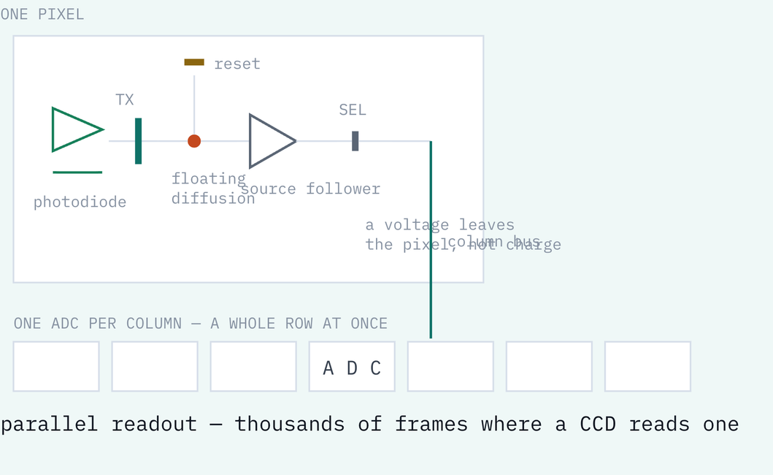
FROM ALERT TO ARCHIVE · TDMMA 2026
DETECTORS
11 / 33
DETECTORS · FROM PHOTON TO NUMBER
CMOS: convert to voltage inside the pixel.
Four transistors, per pixel
A pinned photodiode, a transfer gate, a floating diffusion and a source follower. The charge never leaves home: it becomes a voltage inside the pixel, and the voltage is what travels.
Sampling, also in the pixel
Read the diffusion after reset, pulse the transfer gate, read it again. The sense node is tiny, so its capacitance is tiny, so conversion gain is huge — which is how read noise gets below a single electron.
An ADC per column
Every column digitises simultaneously, so an entire row converts in one step. That parallelism is the whole speed advantage, and the reason a CMOS camera sips power.
Dual conversion gain
Switch an extra capacitor onto the sense node and you trade read noise against full well. You can see that switch in our own sensor between gain 60 and 120: 3.2 e- / 38 000 e- becomes 1.1 e- / 13 000 e-.
The price of an amplifier in every pixel: every pixel has its own gain and its own offset — and both must be calibrated out
OPEN
WHY
PIPELINE
DETECTORS
EXPOSURE
SIMULATOR
NODE
Notes:
The payoff is the last block: dual conversion gain is not a marketing feature, it is a capacitor being switched onto the sense node, and you can see it happening in our own calibration table between gain 60 and 120. That is the moment the theory becomes our instrument.

Slide 10
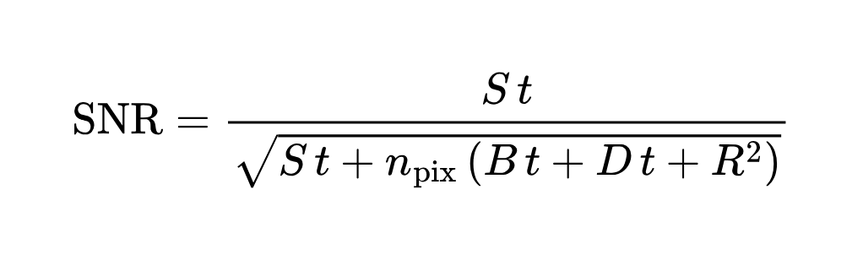
FROM ALERT TO ARCHIVE · TDMMA 2026
DETECTORS
12 / 33
DETECTORS · FROM PHOTON TO NUMBER
Every electron in the well is one of four things.
S — SOURCE
B — SKY
D — DARK CURRENT
R — READ NOISE
Photons from the target. Poisson, so the noise is sqrt(S t): the one term you cannot reduce, only outlast.
The night sky in every pixel of the aperture. Under a city it dominates, and it is why a bigger PSF costs you signal-to-noise.
Electrons freed by heat, not light. Roughly doubles every 6-7 degrees C, which is the entire argument for cooling the sensor.
Added once per pixel per readout by the amplifier and ADC. No t in it — so it is a penalty per frame, not per second.
READ-NOISE LIMITED — SHORT SUBS
SKY LIMITED — LONG ENOUGH SUBS
When n R-squared dominates, every extra frame adds a fresh dose of read noise. Stacking is lossy, and a hundred short subs are worse than ten long ones.
Once n B t is much greater than n R-squared the amplifier stops mattering. Stacking becomes free, SNR grows as sqrt(N), and sub length is set by tracking and saturation instead.
This line is snr_single() in crito/transient/exposure.py — the planner is this equation and its two bounds, nothing more
OPEN
WHY
PIPELINE
DETECTORS
EXPOSURE
SIMULATOR
NODE
Notes:
Every symbol here is a physical population of electrons, and the whole exposure planner is this one line. The two regimes are the practical content: read-noise-limited means every extra sub costs you, sky-limited means stacking is free.

Slide 11
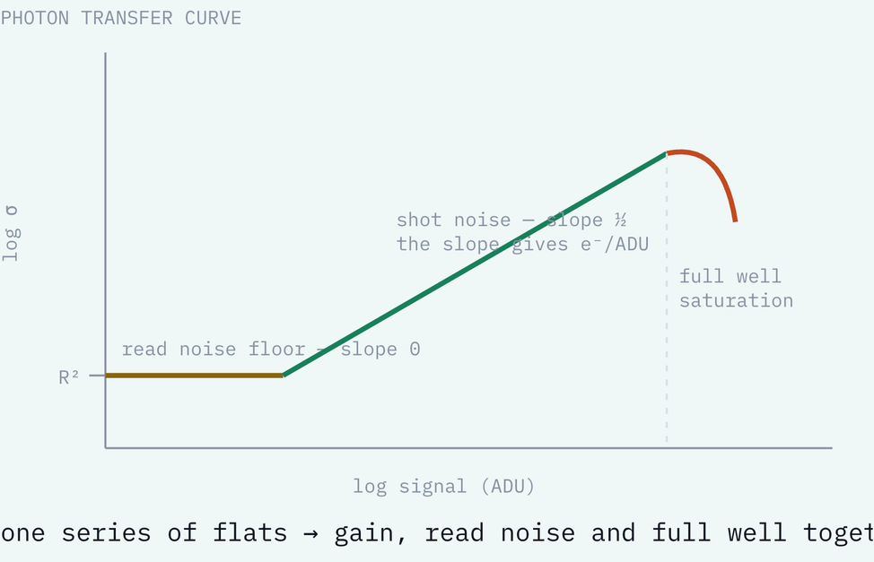
FROM ALERT TO ARCHIVE · TDMMA 2026
DETECTORS
13 / 33
DETECTORS · FROM PHOTON TO NUMBER
The camera reports ADU. The physics is in electrons.
Bias
A zero-second read. What comes back is the electronic offset plus the read noise — the detector talking to itself with the shutter shut.
Dark
The same exposure with no light. Thermal electrons, plus amp glow if the sensor has it. Subtracting it is why the sensor is held at a known, cold temperature.
Flat
A uniformly lit field. It carries per-pixel quantum efficiency, vignetting and every dust shadow in the optical path — divided out, not subtracted.
Photon transfer curve
Plot variance against signal across a flat series. Because shot noise is Poisson, the slope is the system gain in e-/ADU, the floor is read noise, and the turnover is full well.
On CMOS this must be repeated at every gain setting — which is exactly why our calibration table is keyed by gain
OPEN
WHY
PIPELINE
DETECTORS
EXPOSURE
SIMULATOR
NODE
Notes:
The bridge slide: every constant the planner needs is measured, not looked up. The photon transfer curve is the elegant part — one series of flats, plotted as variance against signal, hands you gain, read noise and full well at once, because Poisson statistics tie the variance to the mean.

Slide 12
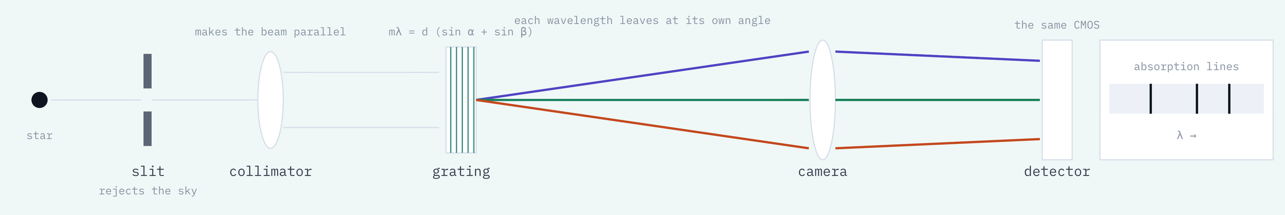
FROM ALERT TO ARCHIVE · TDMMA 2026
DETECTORS
14 / 33
DETECTORS · FROM PHOTON TO NUMBER
A spectrum is a photograph of light that has been sorted.
THE SLIT
THE DISPERSER
THEN THE USUAL WORK
WHAT R BUYS
Isolates the target and rejects the sky beside it. Its projected width sets the resolution element — and throws light away whenever the seeing is wider than the slit.
A grating sends order m of wavelength L off at angle B. Change L and B changes, so the camera lens lands every wavelength in its own detector column.
Bias, dark and flat as before — then trace it, extract a 1D profile, subtract sky either side, and calibrate against an arc lamp and a standard star.
R = 100 — broad hydrogen lines, enough to type a supernova. R = 600 — ejecta velocities. R = 50 000 — radial velocities and exoplanet masses.
OPEN
WHY
PIPELINE
DETECTORS
EXPOSURE
SIMULATOR
NODE
Notes:
The point students miss: a spectrograph does not have a special detector. It is the same CCD or CMOS, photographing light that has been sorted by angle before it lands. Everything about bias, dark, flat and read noise applies unchanged.

Slide 13
FROM ALERT TO ARCHIVE · TDMMA 2026
SENSORS & EXPOSURE
15 / 33
DETECTORS
What we are actually pointing.
ELEMENT | DEVICE | DETAIL | CONSEQUENCE
Optics | Sky-Watcher Explorer 200P | 200 mm · f/5 · 1000 mm | photon budget
Mount | Sky-Watcher EQ6-R Pro | EQMod over INDI | 300 s subs guided
Science camera | QHY miniCAM8 | IMX585 · 2.9 µm | 0.60 ″/px
Guider | ToupTek G3M662M | IMX662 · PHD2 | tracking residual
Focuser | ToupTek AAF | absolute, HFR sweep | no manual focus
Site | IUB rooftop, Dhaka | 23.81 °N · 90.42 °E · 8 m | bright urban sky
A 200 mm aperture under a city sky. The interesting question is not what that can't do — it's exactly where the line falls, and whether we can state it precisely enough for a partner network to schedule against.
OPEN
WHY
PIPELINE
DETECTORS
EXPOSURE
SIMULATOR
NODE
Notes:
Keep this short — it's setup for the two slides that follow. The number that matters is 0.60 arcsec/pixel: at 3-arcsec seeing the PSF is 5 pixels across, which sets the photometry aperture and therefore every noise term on the next slide.

Slide 14
FROM ALERT TO ARCHIVE · TDMMA 2026
SENSORS & EXPOSURE
16 / 33
DETECTORS
One amplifier, or a million.
CCD — CHARGE SHIFTED TO ONE AMPLIFIER
CMOS — AN AMPLIFIER IN EVERY PIXEL
Every pixel is read through the same electronics, so the response is uniform and there is one gain to characterise. Deep full wells, excellent linearity. But readout is slow and power-hungry, and a saturated star bleeds down its column.
Fast, cheap, low power, and read noise below one electron. The cost: read noise and full well both move with gain, every pixel has its own offset and gain, and many sensors add amp glow. More to calibrate, in exchange for speed.
GAIN | READ NOISE | FULL WELL | SKY-LIMITED FLOOR | MAX SUB, MAG-12 STAR | MAG 19 AT SNR 5
0 | 5.0 e- | 51 000 e- | 83 s | 468 s | 6 x 250 s = 25 min
60 | 3.2 e- | 38 000 e- | 34 s | 349 s | 13 x 102 s = 22 min
120 | 1.1 e- | 13 000 e- | 4.0 s | 119 s | 105 x 12 s = 21 min
200 | 0.9 e- | 9 000 e- | 2.7 s | 83 s | 157 x 8 s = 21 min
The total barely moves, because under a Dhaka sky we are sky-limited at every setting. High gain does not buy depth — it buys an eight-second sub instead of a four-minute one.
OPEN
WHY
PIPELINE
DETECTORS
EXPOSURE
SIMULATOR
NODE
Notes:
The table is computed from this rig's own calibration table, and the result surprised me: total integration barely moves across the whole gain range — 25 minutes down to 21 — because the target is sky-limited at every setting. Gain does not buy depth under a bright sky. It buys sub length, and therefore cadence.

Slide 15
FROM ALERT TO ARCHIVE · TDMMA 2026
SENSORS & EXPOSURE
17 / 33
DETECTORS
Mag 19, R band, SNR 5. How long should we observe ?
22
source 3.31 e⁻/s · sky 3.0 e⁻/s/px · read noise 3.2 e⁻
FWHM 5.0 px at 3″ seeing · aperture 178 px
sub window ≥ 34.1 s (sky-limited floor) … ≤ 300 s (guiding cap)
→ 102 s subs, SNR/sub 1.4, sky-limited
→ 13 subs = 22.2 min → SNR 5.0 · ± 0.21 mag
MINUTES ON SKY
THE TWO BOUNDS THAT FIX A SUB
SAY THIS OUT LOUD
Sky must swamp read noise: t ≥ 10·R²/B. The brightest star must stay linear: t ≤ 0.7·FW / peak. Stack the rest: N = (SNRreq/SNRsub)².
These constants are datasheet estimates, not measurements. Every number here moves once the camera is characterised — which is exactly why crito/calib/characterize.py exists.
OPEN
WHY
PIPELINE
DETECTORS
EXPOSURE
SIMULATOR
NODE
Notes:
This is the technical centre of the talk. Two bounds fix the sub length and neither is a preference: below the sky-limited floor you pay read noise on every frame; above the saturation ceiling you clip. If the room is with you, derive N = (SNR_req/SNR_sub)² on the board.

Slide 16
FROM ALERT TO ARCHIVE · TDMMA 2026
SENSORS & EXPOSURE
18 / 33
DETECTORS
The same planner, told honestly.
TARGET | REQUIRED SNR | SUB | SUBS | ON SKY | Σ MAG
R = 17 | 20 | 102 s | 6 | 10 min | ± 0.050
R = 19 | 5 | 102 s | 13 | 22 min | ± 0.212
R = 20 | 5 | 102 s | 78 | 2.2 h | ± 0.217
R = 19 | 20 | 102 s | 199 | 5.7 h ⚠ | ± 0.054
Under a bright urban sky, at 200 mm, precision is expensive and depth is worse. The planner refuses to pretend otherwise — it raises a warning at 5.7 hours rather than printing a number.
Knowing precisely what you cannot do is what makes a node worth scheduling.
OPEN
WHY
PIPELINE
DETECTORS
EXPOSURE
SIMULATOR
NODE
Notes:
The slide that earns you the researchers. Don't soften the 5.7-hour row — a follow-up node that overstates its depth wastes a partner's night, which is worse than declining.

Slide 17
FROM ALERT TO ARCHIVE · TDMMA 2026
SENSORS & EXPOSURE
19 / 33
DETECTORS
Photometry stacks the photons. A spectrum spreads them.
INSTRUMENT | RESOLUTION | ELEMENTS | DEPTH COST | IN ONE HOUR, SNR 10 | OUR MAG-19 SN
Broadband filter | R = 5 | 1 | — | mag 19 at SNR 5 in 22 min | 22 min OK
Slitless grating | R = 100 | ~25 | = 1.8 mag | reaches = mag 17 | = 35 h NO
Slit spectrograph | R = 600 | ~150 | = 2.7 mag | reaches = mag 16 | = 210 h NO
WHERE THE MAGNITUDES GO
THIS IS THE OPTIMISTIC VERSION
Disperse a band across N resolution elements and both the source and the sky spread with it, so signal-to-noise falls as sqrt(N) — about 1.25 x log10(N) magnitudes of depth, in the best case.
A sky-limited estimate, before grating efficiency, slit losses and the guiding you need to hold a target on a slit. The real numbers are worse — which is the point.
So typing a supernova is an aperture problem, not a software one. But a grating in the filter wheel costs almost nothing and would reach mag 16-17 in an hour — bright novae, cataclysmic variables, the occasional nearby SN. A real first step, and an honest one.
OPEN
WHY
PIPELINE
DETECTORS
EXPOSURE
SIMULATOR
NODE
Notes:
Do the arithmetic out loud — it is one idea. Photometry piles the whole passband into a single number; a spectrograph spreads those same photons across tens or hundreds of resolution elements, and you pay for that in depth. State the caveat honestly: this is the sky-limited best case, before grating efficiency and slit losses.

Slide 18
FROM ALERT TO ARCHIVE · TDMMA 2026
ON THE SIMULATOR
21 / 33
LIVE ON THE SIMULATOR
Alert to archived frame.
01
Bring up the simulated observatory
05
Plan its exposure
indiserver · telescope · ccd · guider · focuser · wheel · dome
magnitude + target SNR → subs, count, total
02
Scan and connect every device
06
Launch and narrate
Devices → Auto-detect & connect all
slew → plate-solve → centre → autofocus → guide → expose
03
Poll ALeRCE live
07
Open the archived frame
observable tonight, grouped by class, scored
WCS tagged, HFR and background measured, provenance in the header
04
Approve one candidate
the one human decision in the chain
OPEN
WHY
PIPELINE
DETECTORS
EXPOSURE
SIMULATOR
NODE
Notes:
Simulators, not sky — same visuals, zero chance a cloud eats the slot. Record the whole run beforehand. Known rough edge: ALeRCE's object-list endpoint returns no magnitude, so step 5 needs the magnitude typed by hand.

Slide 19
FROM ALERT TO ARCHIVE · TDMMA 2026
ON THE SIMULATOR
22 / 33
LIVE ON THE SIMULATOR
The whole rig, from four commands.
SIMULATED HARDWARE
docker compose -f deploy/docker-compose.yml --profile sim up -d indi-sim
indiserver + PHD2 in one container — mount, CCD, guider, focuser, wheel, dome on :7624, PHD2 on :4400
WORKSHOP ACCOUNTS
python scripts/seed_workshop_users.py --count 5
workshop1…5, role workshop, every one of them simulation-only
ONE BACKEND PER PARTICIPANT
CRITO_SIMULATION=true CRITO_DB_URL=sqlite+aiosqlite:///data/ws1.db uvicorn crito.core.app:app --port 8021
its own archive, its own plans — and the SIMULATION flag that lights the badge
THEIR CONSOLE
CRITO_BACKEND=http://localhost:8021 yarn dev --port 5174
same console, same code path, different port
A workshop account is an operator on any simulation backend and a spectator on the real one. The flag is read from the database on every write, never from the token — so revoking someone mid-session takes effect on their next click.
OPEN
WHY
PIPELINE
DETECTORS
EXPOSURE
SIMULATOR
NODE
Notes:
Run this once on the demo machine before the session and leave it up. The third line is the one that matters for the workshop: one backend per participant, each with its own database, all pointed at the same simulated rig.

Slide 20
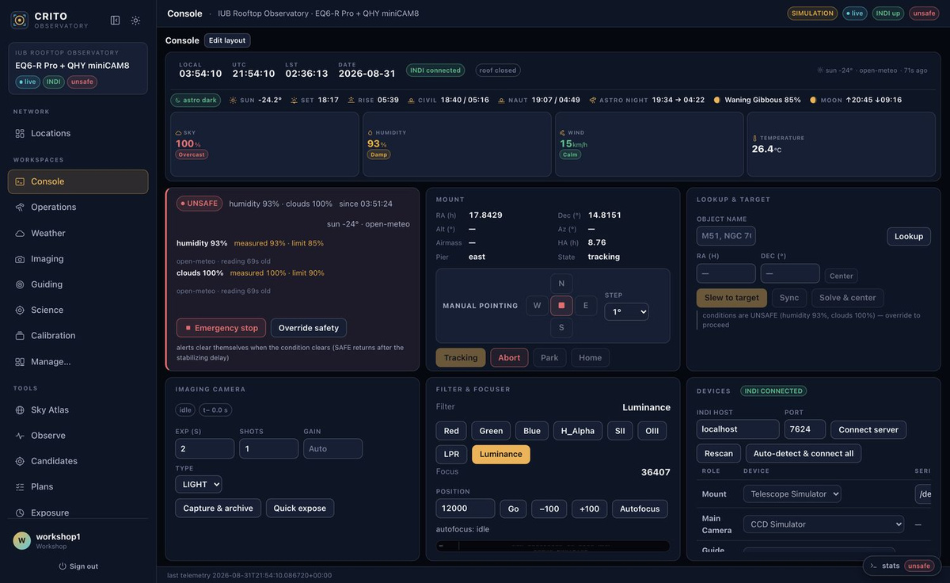
FROM ALERT TO ARCHIVE · TDMMA 2026
ON THE SIMULATOR
23 / 33
LIVE ON THE SIMULATOR
Nothing here knows it isn't a telescope.
1
SIMULATION — this backend is flagged, so the badge rides every page. The real observatory refuses these accounts entirely.
1
2
Signed in as workshop1, role Workshop — full control here, read-only on the real rig.
5
3
INDI at localhost:7624 — the container. The same field points at the pier on the real node.
4
Roles bound to Telescope Simulator and CCD Simulator. Swapping in real hardware changes only this dropdown.
3
4
5
Live Dhaka weather, evaluated for real: UNSAFE at 93% humidity and 100% cloud.
2
Same console · same INDI protocol · same executor · a different driver on :7624
OPEN
WHY
PIPELINE
DETECTORS
EXPOSURE
SIMULATOR
NODE
Notes:
Point at the badge first, then the INDI host field. The message is that nothing is mocked — identical code path, identical protocol, identical console; only the driver on the other end of :7624 differs.

Slide 21
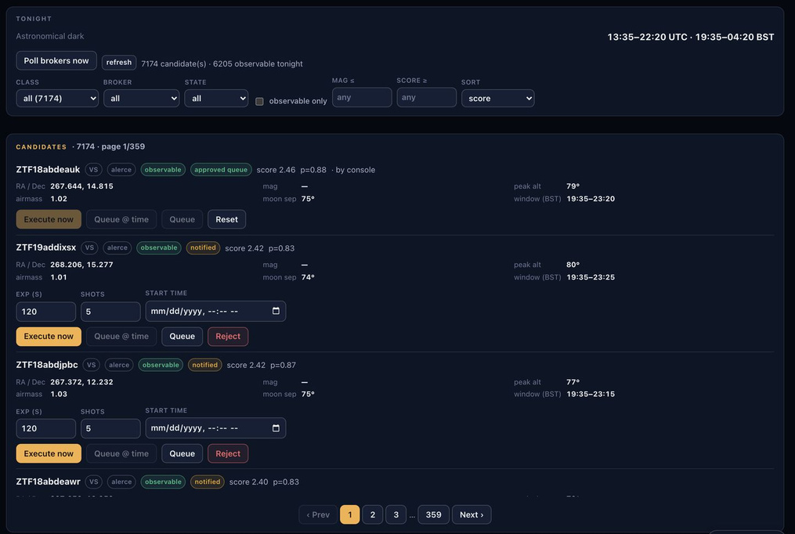
FROM ALERT TO ARCHIVE · TDMMA 2026
ON THE SIMULATOR
24 / 33
LIVE ON THE SIMULATOR
7,174 alerts in. 6,205 up from Dhaka tonight.
1
Poll brokers now — ALeRCE, Fink and Swift, fire-and-forget so a slow broker never blocks the console.
1
2
2
7174 candidates · 6205 observable tonight — the visibility filter has already run against this site's horizon and Moon.
3
4
5
3
mag —: ALeRCE's object endpoint returns no magnitude. A real gap, and why the planner needs it typed by hand.
4
Per-target peak altitude, airmass, moon separation and observing window — computed here, not by the broker.
5
The one human decision: Execute now, Queue, or reject.
ALeRCE · Fink · Swift GCN — normalised to one alert row, de-duplicated by object id
OPEN
WHY
PIPELINE
DETECTORS
EXPOSURE
SIMULATOR
NODE
Notes:
Live ALeRCE data, not a fixture. Say the magnitude gap out loud when you reach it — you have to type the magnitude into the planner on the next slide anyway.

Slide 22
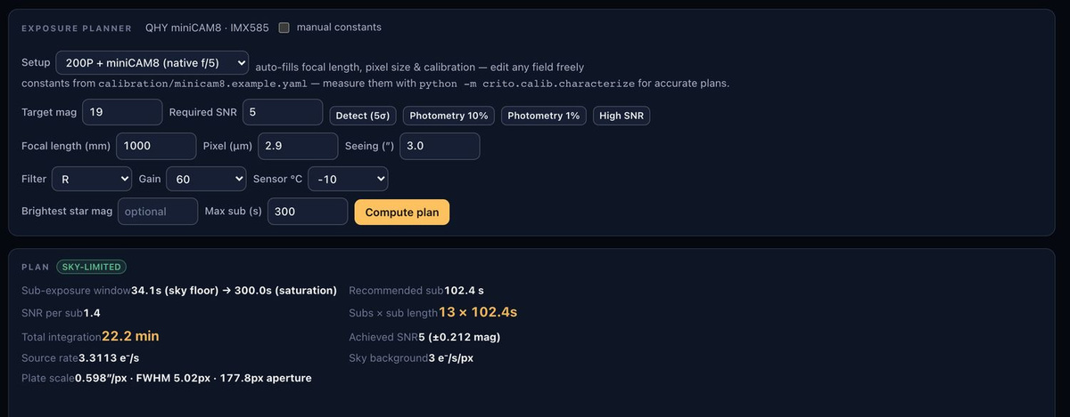
FROM ALERT TO ARCHIVE · TDMMA 2026
ON THE SIMULATOR
25 / 33
LIVE ON THE SIMULATOR
The same arithmetic as slide 9, in the room.
1
2
3
4
5
1
Type the candidate's magnitude and the SNR the science needs — mag 19, SNR 5.
2
R band, gain 60: read noise and full well come from the per-gain calibration table.
3
34.1 s floor (sky swamps read noise) → 300 s ceiling (the guiding cap you set).
4
13 × 102.4 s — the stack that reaches the requested SNR.
5
22.2 minutes on sky, SNR 5, ±0.212 mag. The number from slide 9, computed live.
OPEN
WHY
PIPELINE
DETECTORS
EXPOSURE
SIMULATOR
NODE
Notes:
The payoff for the exposure section — the slide and the tool agree because they are the same function. If you have a minute, change SNR from 5 to 20 on stage and let the room watch it jump to 5.7 hours.

Slide 23
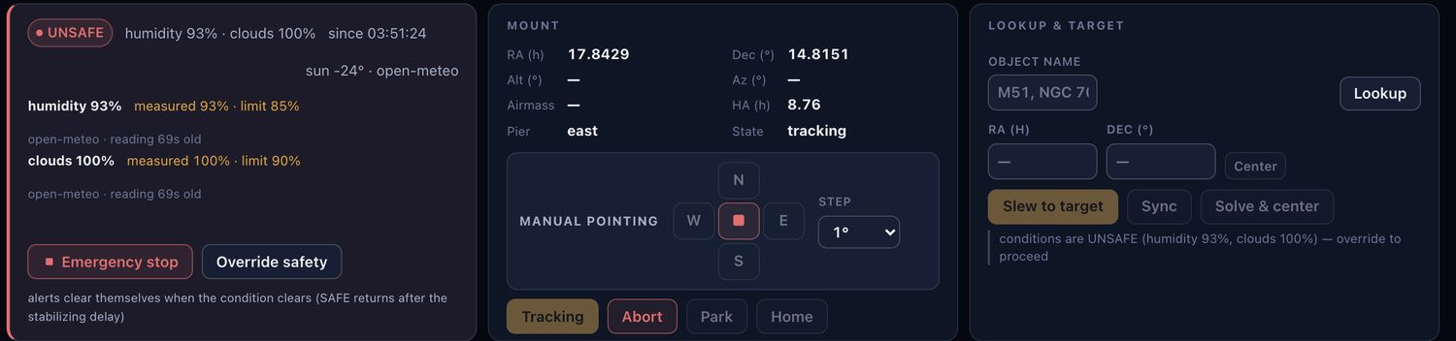
FROM ALERT TO ARCHIVE · TDMMA 2026
ON THE SIMULATOR
26 / 33
LIVE ON THE SIMULATOR
It will not slew, and it says exactly why.
1
2
4
3
1
State, cause and duration — UNSAFE, humidity 93%, clouds 100%, since 03:51.
2
Every limit shown with its measured value, its threshold and the age of the reading. A stale sensor is itself unsafe.
3
The refusal is written on the control: conditions are UNSAFE — override to proceed.
4
An operator can take responsibility. Nothing overrides it silently, and the override is logged.
The same gate runs server-side — anything clickable is also curlable
OPEN
WHY
PIPELINE
DETECTORS
EXPOSURE
SIMULATOR
NODE
Notes:
This was not staged — it is genuinely overcast in Dhaka and the FSM is doing its job on stage. Make the point about symmetry: the same check runs in the backend, so a stale browser tab or a curl gets the same 409 the button gets.

Slide 24
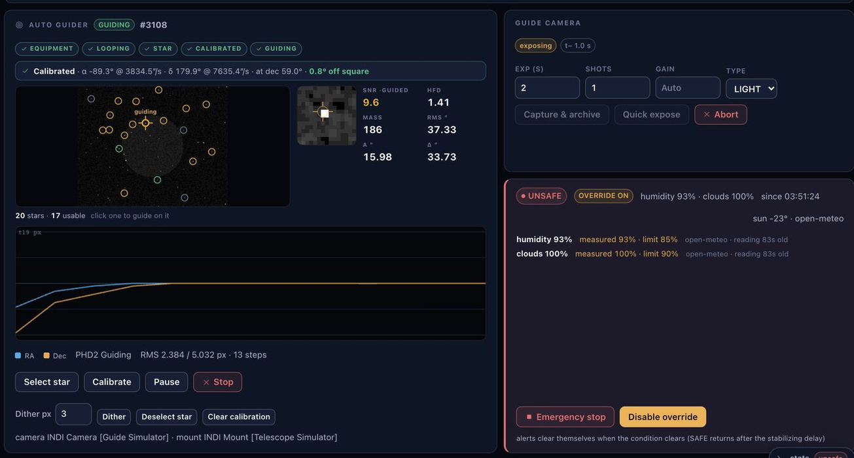
FROM ALERT TO ARCHIVE · TDMMA 2026
ON THE SIMULATOR
27 / 33
LIVE ON THE SIMULATOR
PHD2, calibrated and locked, in the container.
1
The full state machine, honestly reported: equipment → looping → star → calibrated → guiding.
1
2
2
Live SNR 9.6, HFD 1.41 on the guide star — the numbers that decide whether a sub is worth keeping.
5
3
3
20 stars, 17 usable. Click any one to guide on it instead.
4
4
RA and Dec residuals, RMS in pixels, updating per guide frame.
5
OVERRIDE ON — still unsafe, still visible, now an operator's explicit decision.
PHD2 event server on :4400 — calibration, star selection, dithering and settle all driven from the console
OPEN
WHY
PIPELINE
DETECTORS
EXPOSURE
SIMULATOR
NODE
Notes:
PHD2 is a real build running in the container against the guide simulator, talking the real event protocol on :4400 — not a stub. Guiding is the most common reason an unattended night quietly produces nothing.

Slide 25
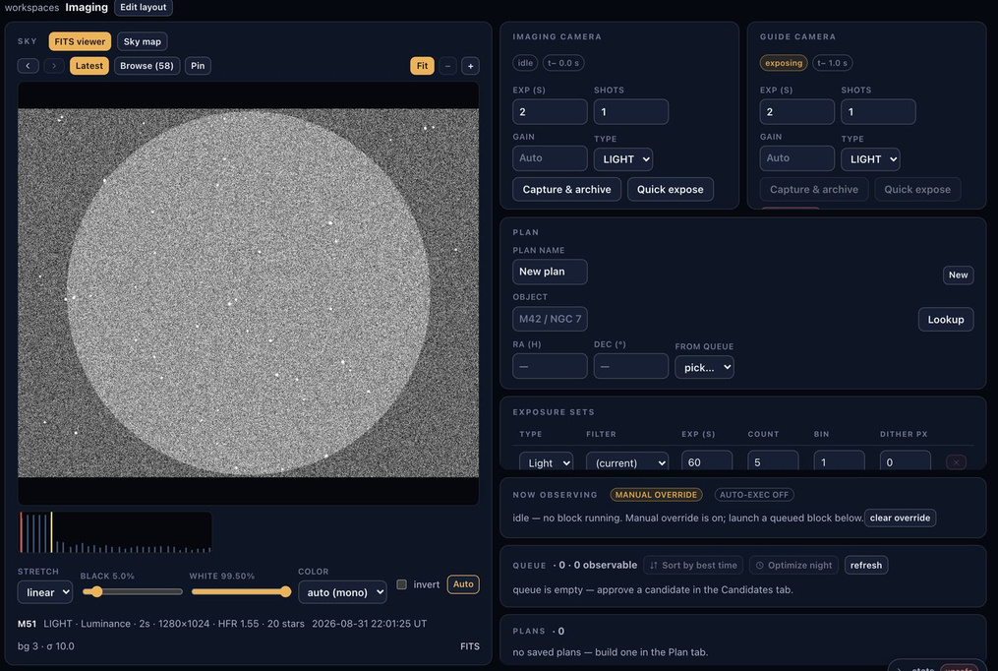
FROM ALERT TO ARCHIVE · TDMMA 2026
ON THE SIMULATOR
28 / 33
LIVE ON THE SIMULATOR
Alert to archived FITS, end to end.
1
Capture & archive — the frame is written to the night's archive, never held in the browser.
3
1
2
The simulated field, stretched in the console's FITS viewer.
2
3
58 frames already in tonight's archive, browsable in place.
4
M51 · LIGHT · Luminance · 2 s · 1280×1024 · HFR 1.55 · 20 stars · 22:01:25 UT — focus quality and star count measured on arrival.
4
HFR and background measured on write · WCS injected from the plate solve · provenance in the header
OPEN
WHY
PIPELINE
DETECTORS
EXPOSURE
SIMULATOR
NODE
Notes:
Close the demo here and go back to the pipeline slide for one sentence. The claim you have just demonstrated is the whole talk: a broker alert became a calibrated, measured, archived frame with no one touching a telescope.

Slide 26
FROM ALERT TO ARCHIVE · TDMMA 2026
ON THE SIMULATOR
29 / 33
YOUR TURN
Assignment: find the wall yourself.
PART 1
25 MIN · ON PAPER
PART 2
45 MIN · ON THE SIM
Plan it
Fly it
R = 18.0 · SNR 10 · gain 60
R filter · 3″ seeing · f = 1000 mm
subs capped at 300 s by guiding
Log in to your workshop account. Put Part 1 into the Exposure tab — the planner must agree with your paper. If it doesn't, one of you is wrong; find out which.
Derive, in order:
Then approve a candidate, launch it, and do the whole chain: slew → plate-solve → centre → autofocus → guide → expose. Open the frame it archives.
1. the sky-limited floor t ≥ 10R²/B
2. the saturation ceiling t ≤ 0.7·FW/peak
3. a sub length inside that window
4. SNR per sub, then N = (SNR / SNR_sub)²
5. total on-sky time and sigma_mag
HAND IN → from the FITS header:
OBJECT · FILTER · EXPTIME · CRVAL1/2 · HFR · star count
HAND IN → seven numbers, with the working tool
DELIVERABLE
One page — the numbers from part 1, the header from one of the sub exposure , one screenshot of image from crito .
≈ 90 min
OPEN
WHY
PIPELINE
DETECTORS
EXPOSURE
SIMULATOR
NODE
Notes:
Brief this in three minutes, then get out of the way. Part 1 is arithmetic they can check, Part 2 proves the arithmetic drives a real telescope, and Part 3 is the only part with a lesson in it.
ANSWER KEY, PART 1 — floor 34.1 s, ceiling 300 s (the GUIDING cap binds, not saturation — worth asking why), sub 102.4 s, SNR/sub 3.55, N = 8, total 13.7 min, sigma 0.108 mag.
ANSWER KEY, PART 3 — R = 19.9 (65 subs, 111 min); R 19.95 needs 123 min and busts the budget. Gain 200 changes almost nothing: 13.6 min against 13.7 min at R = 18, because the target is sky-limited. Lower read noise only lets you use shorter subs; it adds no signal. Depth goes as dm = 1.25*log10(t2/t1), so five times the time buys 0.9 mag, and no gain setting alters that. Anyone who notices that gain 200 also collapses full well to 9,000 e- — and would bind the saturation ceiling on a bright field star — has read the whole table; say so.
FILL IN THE ACTUAL DEADLINE BEFORE YOU PRESENT THIS.

